Slide 1
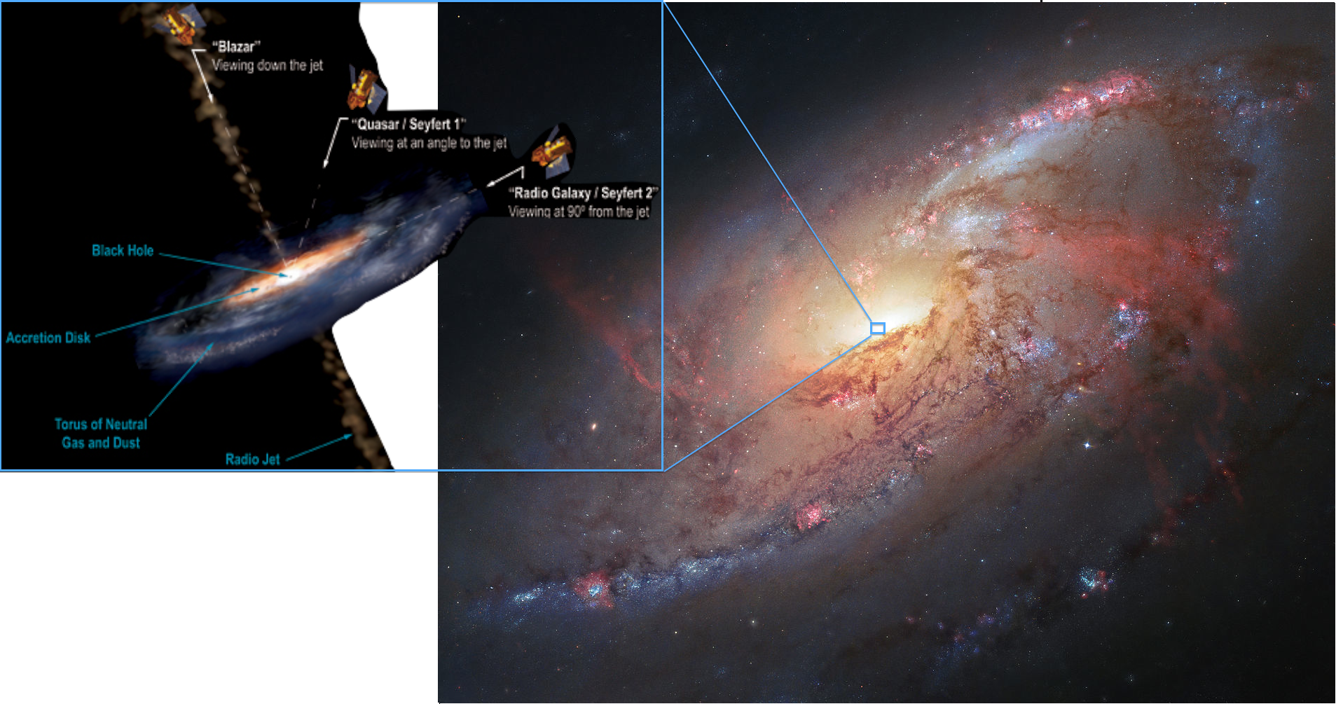
Probing the Connection Between Water Maser and X-ray Emission in Galaxy Centers
Drew Nutter

Slide 2
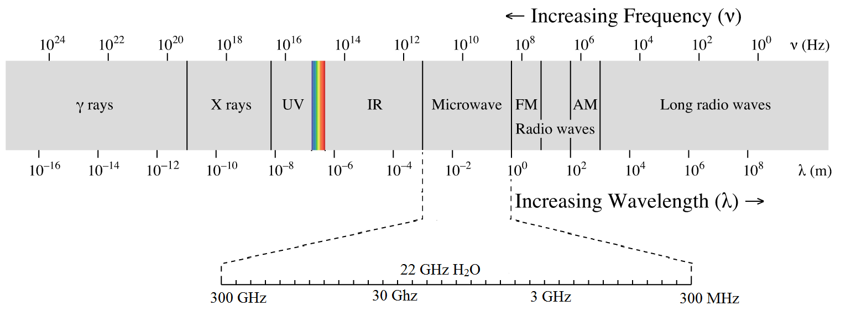
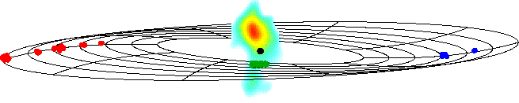
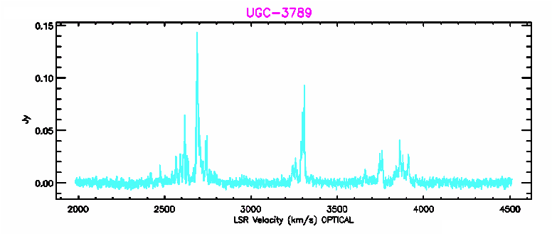
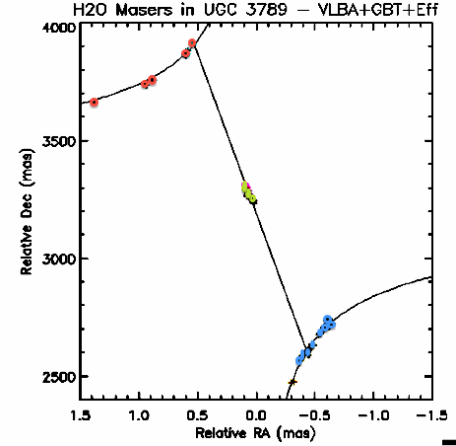
Megamasers
Identified by 22 GHz microwave emission.
4% of galaxies have megamaser emission.
Only 20% of those 4% are in disk configuration.
Cosmology
Directly calculate extragalactic distances.
Hubble Constant
Supermassive Black Hole
Most accurate measurement for mass

Slide 3
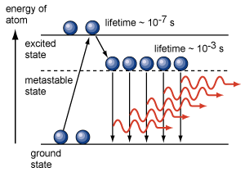
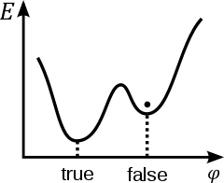
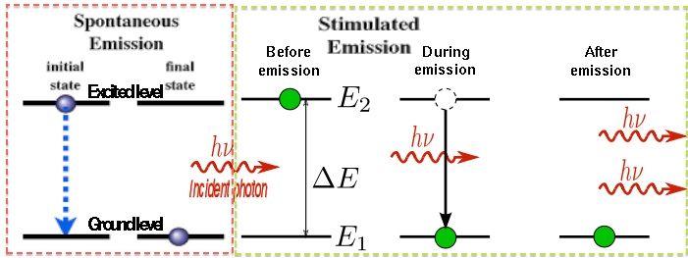
MASER
Microwave Amplification by Stimulated Emission of Radiation
Masing process
Population inversion to a metastable excited state
H₂O molecule de-excites: radiate 22 GHz photon
Photon stimulates de-excitation 22 GHz emission from other molecule
Metastability
Notes:
--we might need to combine info on slides 2 & 3.

Slide 4
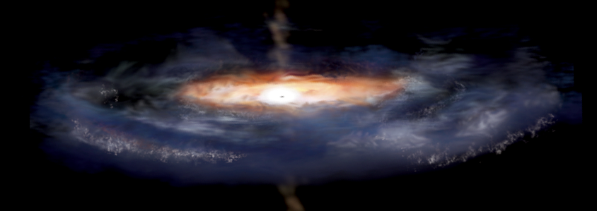
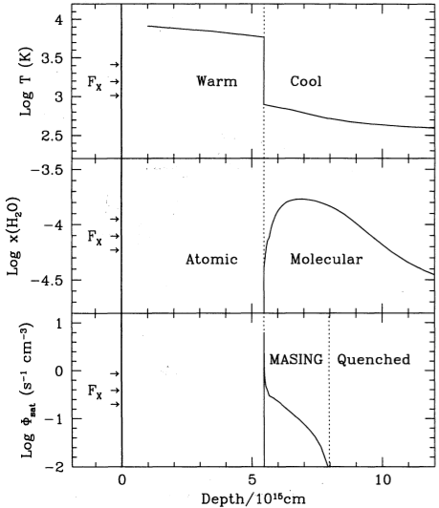
Masing Conditions in Megamasers
- Active Galactic Nucleus (AGN): Central supermassive black hole with active accretion.
- X-ray emission from accretion disk heats surrounding clouds of gas.
- This heat provides energy to create population inversion required for maser emission.
H₂O Maser Requirements:
- Cool enough to form molecules
- Warm enough for population inversion.
- High abundance of H₂O
Non-masing zones:
-Inner area too hot: Atoms only.
-Outer area too cool: Quenched.
-Through radiative trapping, outer area insulates middle masing area
Temperature
H2O
Abundance
Maser
Emission
Neufeld et al. 1994

Slide 5
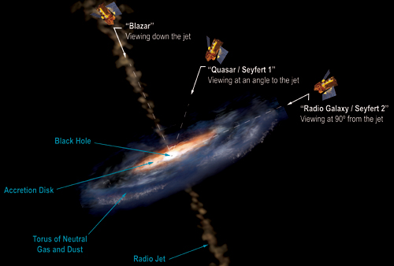
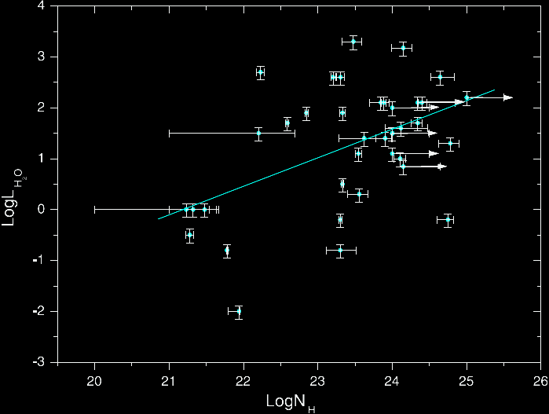
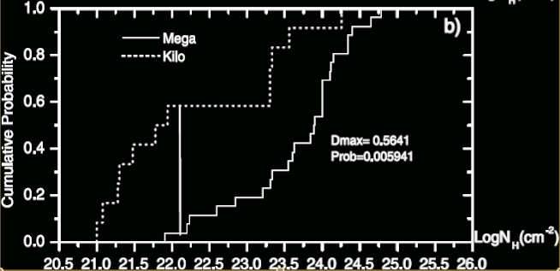
Obscuration
Column Density (N_{H}): Density of Hydrogen atoms along the line of sight.
- Intrinsic N_{H}: Column density inherent to object viewed
- Galactic N_{H}: Column density within Milky Way
- Torus around accretion disk obscures X-ray emission (intrinsic N_{H})
- Differing levels of obscuration depending upon angle viewed
- Strength of maser emission may correlate to column density.
- Maser clouds may increase obscuration.
- Greater numbers are needed for more conclusive evidence.

Slide 6
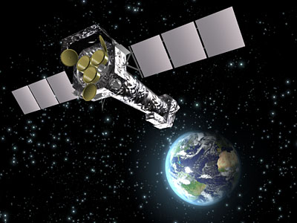
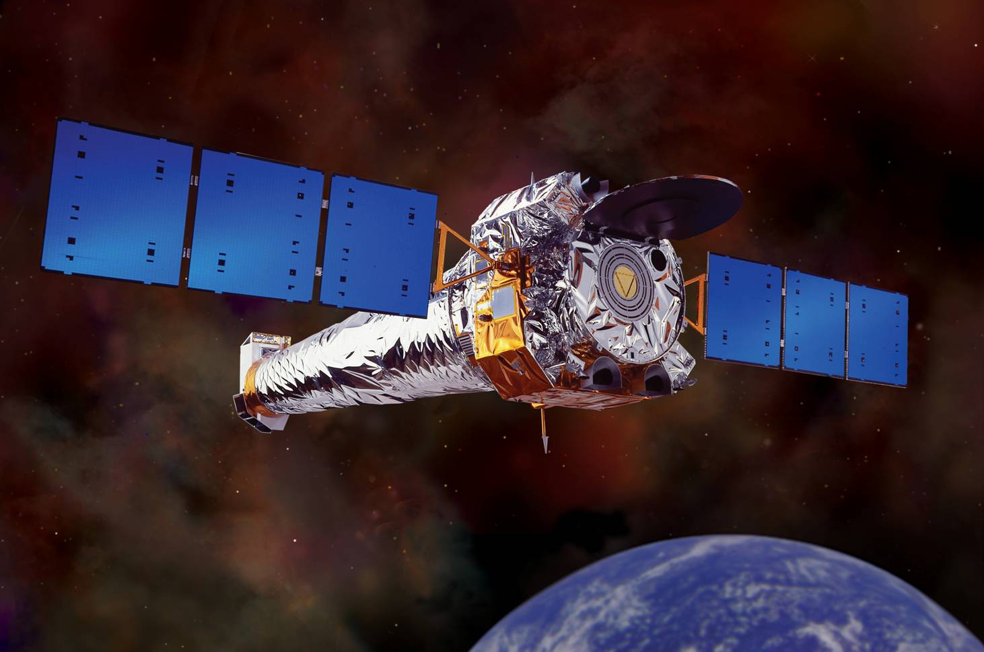
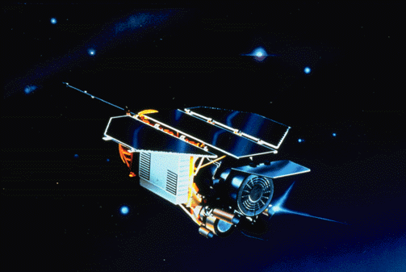
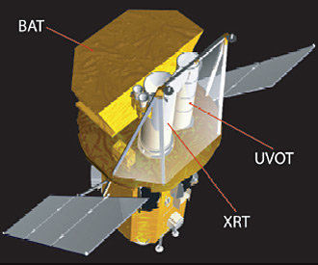
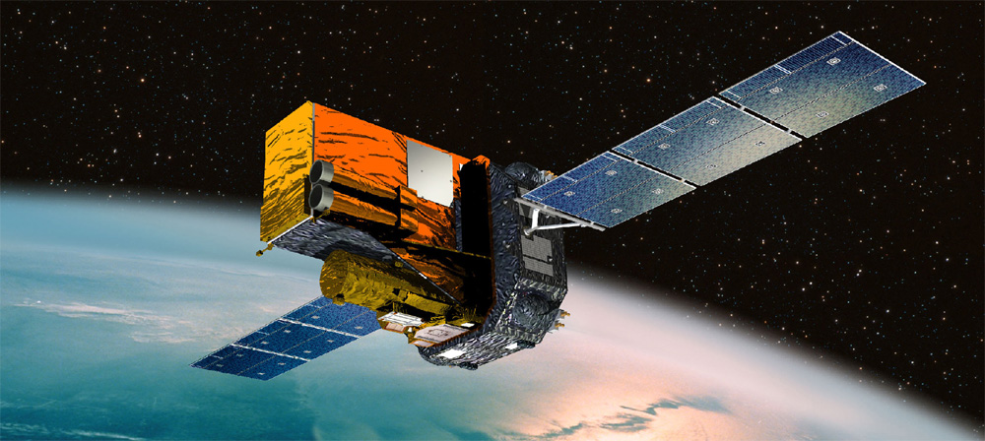
Catalogs
Previous Studies: 40 total galaxies examined with varying degrees of maser emission.
Megamaser Cosmology Project
- 151 total megamasers found
(103 in X-ray catalogs)
- 3339 non-maser galaxies identified (650 in X-ray catalogs)
XMM-Newton Serendipitous Survey
0.2 – 12 keV (soft X-ray)
Chandra Source Catalog
0.1-10 keV (soft X-ray)
ROSAT All-Sky Survey (RASS)
0.1-2.4 keV (soft X-ray)
Swift Burst Alert Telescope 70 month Survey
14 – 195 keV (hard X-ray)
Integral IBIS 7 year Survey
17 – 60 keV (hard X-ray)

Slide 7
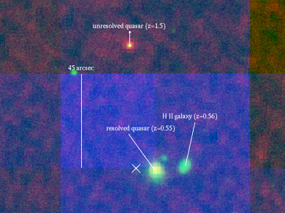
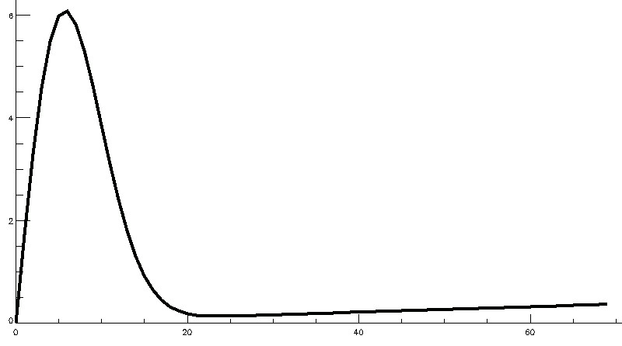
Cross-matching X-ray catalogs
MCP objects identified by finding objects in X-ray catalog within given angular separation.
Telescopes’ varying accuracies make crossmatching difficult.
Must select angular separation that avoids mismatches and includes positive matches.
Parejko et al. 2008
Histogram of all matches fits Rayleigh distribution with linear component for randoms.
Ideal search should identify where random matches begin to dominate.

Slide 8
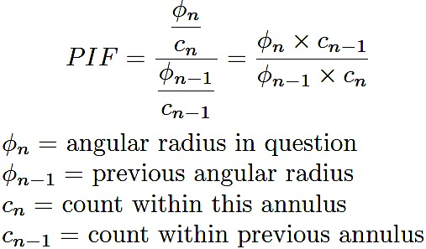
Selecting Angular Separation
Percent Increase Factor (PIF): Novel method developed to aid angular separation selection.
Represents rate of change of number of matches per annulus between search radii.
Maximum approximates inflection points over curve that would fit histogram.
Inflection point signals beginning of dominance of random matches (linear component).
Chandra
Notes:
Motivation for this method to find correct crossmatches? Image from parejko paper can be used
slide 7: too crowded, text too small. better to have the labels for the different catalogs inside the plots. in fact, might be able to use some empty space in the plots for text. we'll talk.

Slide 9
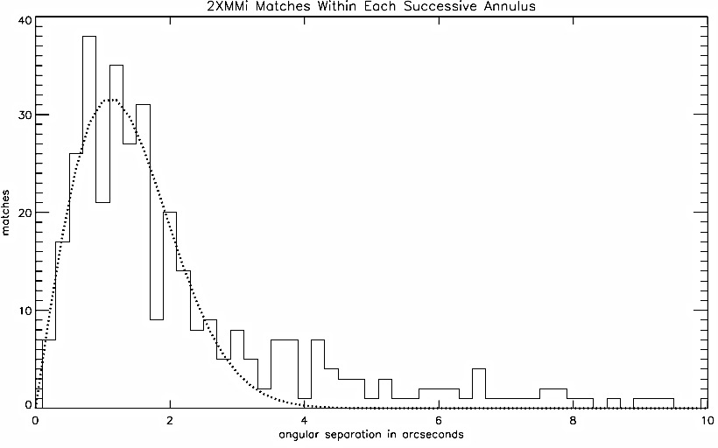
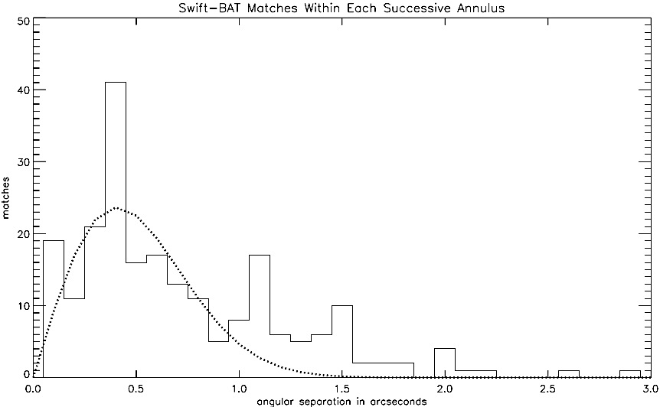
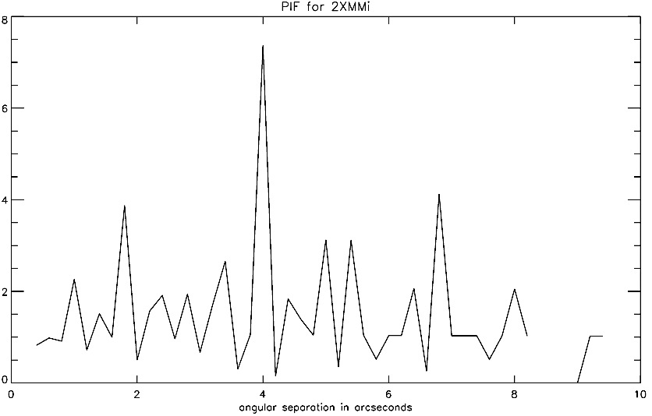
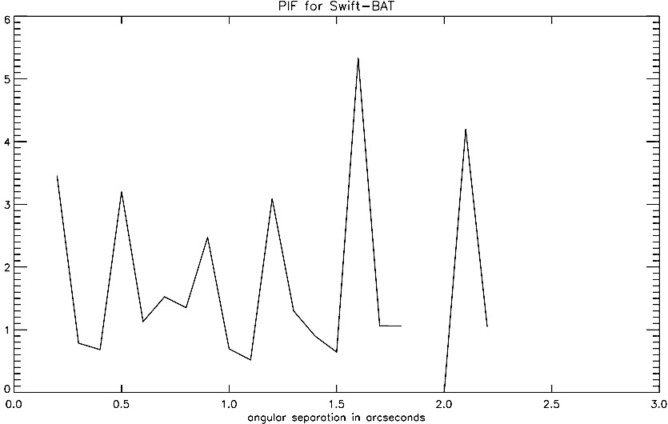
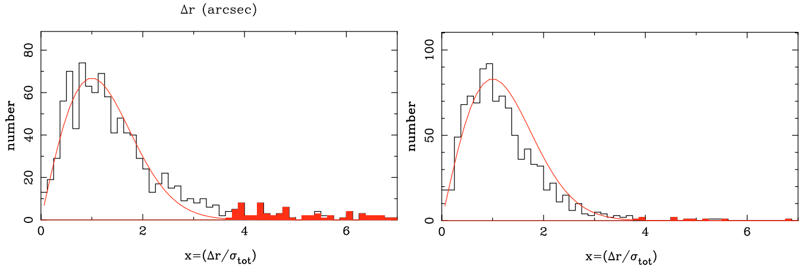
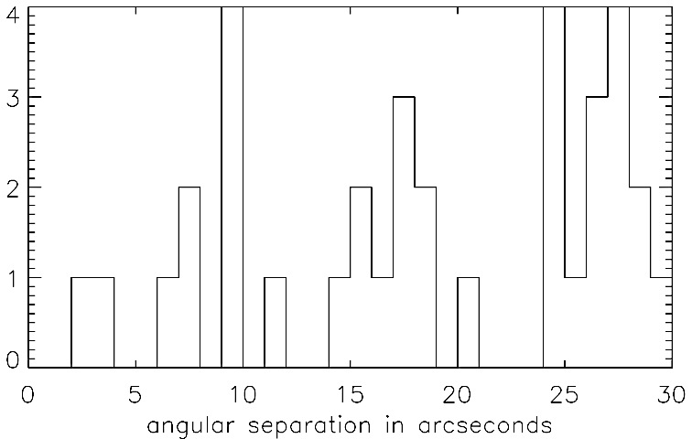
Accounting for Positional Error
Swift-BAT has very similar distribution, same pattern observed. 3” instead of 1.5”
XMM-Newton catalog identified matches outside fit as true matches
7” selected instead of 4”
matches
matches
PIF
PIF
2 4 6 8
0.5 1 1.5 2 3
Integral
Integral: 20”
Watson et al. 2009 (2XMM)
Notes:
same with slide 8, needs organization.

Slide 10
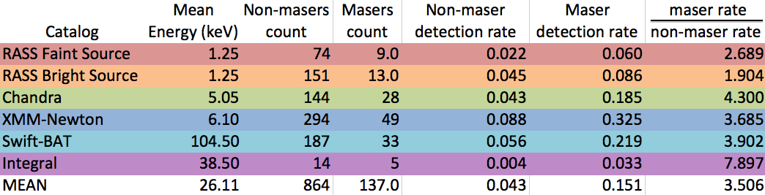
Detection rates
Masers have X-ray detection rate 3.5 times as great as non-masers

Slide 11
Calculated flux for each object considering catalog’s flux or count rate
Used Galactic (Milky Way) N_{H} to account for absorption.
Merged Chandra and XMM-Newton data for 0.5-10 keV range.
Similar fluxes between masers and non-masers for soft X-rays. (mean flux values listed)
In harder X-rays (higher energy), masers have increasingly greater flux than non-masers.
X-ray Fluxes
-11.93
-11.85
-12.28
-12.35
-9.87
-10.41
-10.34
-10.56
Notes:
-then, write conclusions from the comparisons shown in the plots. Add then some more labels with colors in the pptx. otherwise, they are all the same.

Slide 12
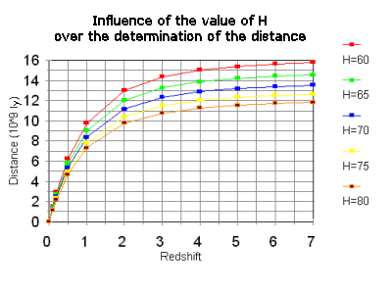
Luminosity Distance
Calculating astronomical distances is tricky.
Luminosity distance(d_{L}): Distance light has traveled, not necessarily actual distance.
Modeled from redshift based on estimate of Hubble constant.
Varies widely depending on model.
Necessary to determine intrinsic luminosity of an object from its flux.
Masers are important partly because they can give us a method to directly calculate this.

Slide 13
X-ray Luminosity
L = 4π × d_{L}² × F
Non-masers consistently more luminous (mean luminosity values listed).
40.78
42.10
40.99
41.28
43.05
43.61
43.02
43.46

Slide 14
Discussion
Data resulting from crossmatch represents X-ray active subset of MCP all-surveyed.
High maser detection rate suggests megamasers are more X-ray active than non-masers.
Megamaser galaxies are increasingly active in harder X-rays.
Among X-ray active sources, non-maser sources are more X-ray luminous than masers.
Maser emission previously associated with obscuration.
Lower intrinsic luminosities may represent X-ray obscuration, providing evidence for new constraint in megamaser search.

